Slide 1

Clustering Algorithms as a Means of Identifying Patterns of Bias
Dylan Rohan
Notes:
You have provided a brief but thorough overview of your research project following the provided slide structure. You have introduced your project title, research problem or challenge, research question/s, task/s and dataset/s. The project is introduced and contextualised in a concise (brief but comprehensive) manner.

Slide 2
Contents
Problem description
Incentives
Research Question
Selected reference domain
Overview
Methodology
Phase 1
Phase 2
Phase 3
Phase 4
Results
Exploratory Data analysis
Principal component analysis
Uniform Manifold Approximation and Projection
K-means
DBSCAN
HDBSCAN
Statistical Analysis
Conclusion
Demonstration
References

Slide 3
Problem Description
Many systems and organizations struggle to accurately assess for bias; implicit or otherwise.
Machine learning tools learn bias (Miller, Peek & Parker 2020)(van Giffen, Herhausen & Fahse 2022)
Real world examples (Bivens & Hoque 2018; Garcia, Garcia & Rigobon 2024; Köchling & Wehner 2020; McDavid 2020; Nader 2020; Narr 2021).

Slide 4








Incentives
Current methods involve surveys and self-reporting which are useful but have several issues.
‘Save face’ (Adams, Soumerai et al. 1999; Gorber and Tremblay 2016)
Obfuscation of facts (Lugon Arantes 2021)
Potential inability to capture the bias (Gorber and Tremblay 2016)
Can result in conflict and mistrust
High cost, time consuming, and impact productivity
There are many reason to address bias:
Reduced operational cost and improved market potential
Improves HR policies and workplace behaviours
Improved workplace culture and customer experience
Notes:
State your research problem, any relevant organisational or industry context and your research question/s addressing the research problem.

Slide 5
Research Question
Can clustering algorithms be used to identify potential patterns of bias?
And if so, can it be done in a way that is accessible both conceptually and computationally?

Slide 6
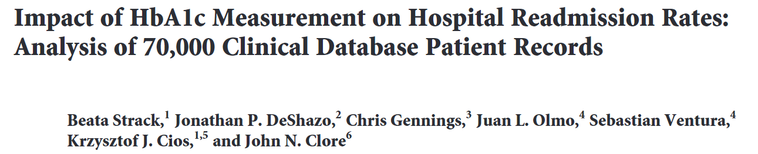
Reference Domain
The American medical system’s struggle with bias is well documented, make it a good model domain.
(Chua 2006; Feagin & Bennefield 2014; Gale 2019; Galvan & Payne 2024; Health 2021; Jindal et al. 2023; Selden 2020)
Ethical considerations:
Reidentification potential
The quality of representation (eg, socioeconomic factors, extreme situations, etc.)
Correlation and not causation – (eg, genetic factors, location factors, etc.)
Source
UC Irvine Machine Learning Repository
https://archive.ics.uci.edu/dataset/296/diabetes+130us+hospitals+for+years+1999-2008
Shape
(101766, 48)
Description
This dataset was first collected by Strack et al. to assess diabetic patient readmissions (2014). The dataset is appropriately licensed for broader use. It contains data collected between 1999 and 2008 from 130 hospitals across America. Includes instances of diabetic diagnoses during hospital admissions with lengths of stay shorter than 15 days.
Notes:
You have provided a clear overview of your research methodology, describing any particular techniques, methods, solutions, processes, components, and tools used in your data collection, processing, analysis, or any other tasks, and explained how you have used them. Methodological choices are clearly justified and appropriate for the program, course, and particular research problem. Relevant examples, visuals, and supporting evidence are used as appropriate.

Slide 7


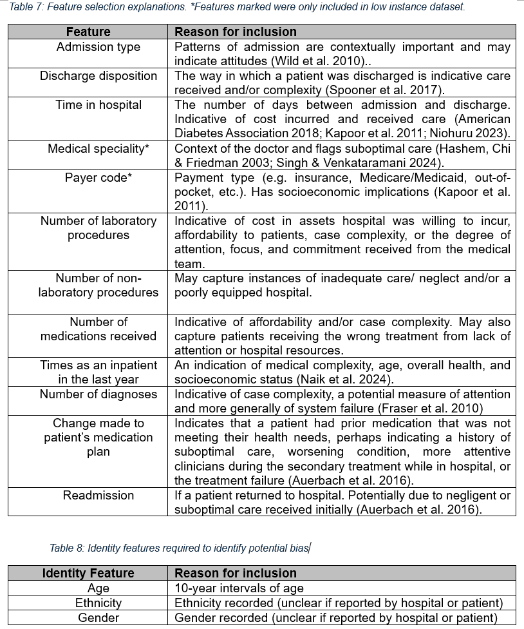
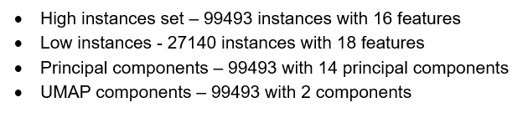
Selected Features

Slide 8



Overview
Essentially, this project aims to use a pre-existing dataset that potentially capture biased patterns indirectly and attempt to find groups using Clustering algorithms with the latent information and feature interactions.
The aim is not to prove a bias. It is to:
Identify groups based on patterns from historical data
Assess those groups to determine if there is an association with an identity feature.
If there is an association, promote a conversation to determine the reason.
Notes:
You have provided a brief, clear and comprehensive overview of the task and data you have identified, developed, and are working with in your project.

Slide 9
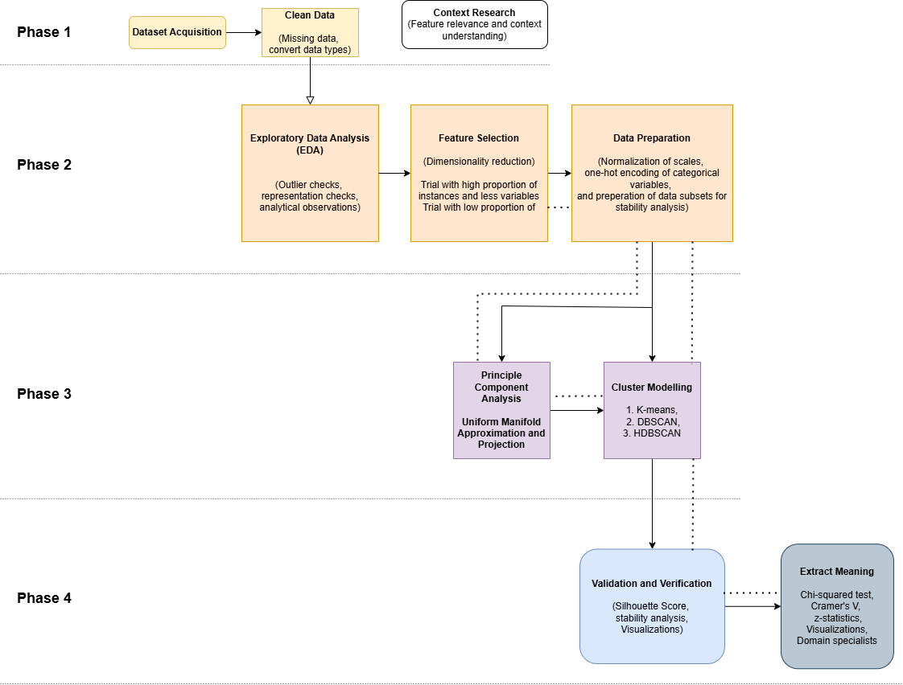
Methodology
Notes:
You have provided a clear overview of your research methodology, describing any particular techniques, methods, solutions, processes, components, and tools used in your data collection, processing, analysis, or any other tasks, and explained how you have used them. Methodological choices are clearly justified and appropriate for the program, course, and particular research problem. Relevant examples, visuals, and supporting evidence are used as appropriate.

Slide 10
Methodology
Notes:
You have provided a clear overview of your research methodology, describing any particular techniques, methods, solutions, processes, components, and tools used in your data collection, processing, analysis, or any other tasks, and explained how you have used them. Methodological choices are clearly justified and appropriate for the program, course, and particular research problem. Relevant examples, visuals, and supporting evidence are used as appropriate.

Slide 11
Methodology
Notes:
You have provided a clear overview of your research methodology, describing any particular techniques, methods, solutions, processes, components, and tools used in your data collection, processing, analysis, or any other tasks, and explained how you have used them. Methodological choices are clearly justified and appropriate for the program, course, and particular research problem. Relevant examples, visuals, and supporting evidence are used as appropriate.

Slide 12
Methodology
Notes:
You have provided a clear overview of your research methodology, describing any particular techniques, methods, solutions, processes, components, and tools used in your data collection, processing, analysis, or any other tasks, and explained how you have used them. Methodological choices are clearly justified and appropriate for the program, course, and particular research problem. Relevant examples, visuals, and supporting evidence are used as appropriate.

Slide 13
Methodology
Notes:
You have provided a clear overview of your research methodology, describing any particular techniques, methods, solutions, processes, components, and tools used in your data collection, processing, analysis, or any other tasks, and explained how you have used them. Methodological choices are clearly justified and appropriate for the program, course, and particular research problem. Relevant examples, visuals, and supporting evidence are used as appropriate.

Slide 14
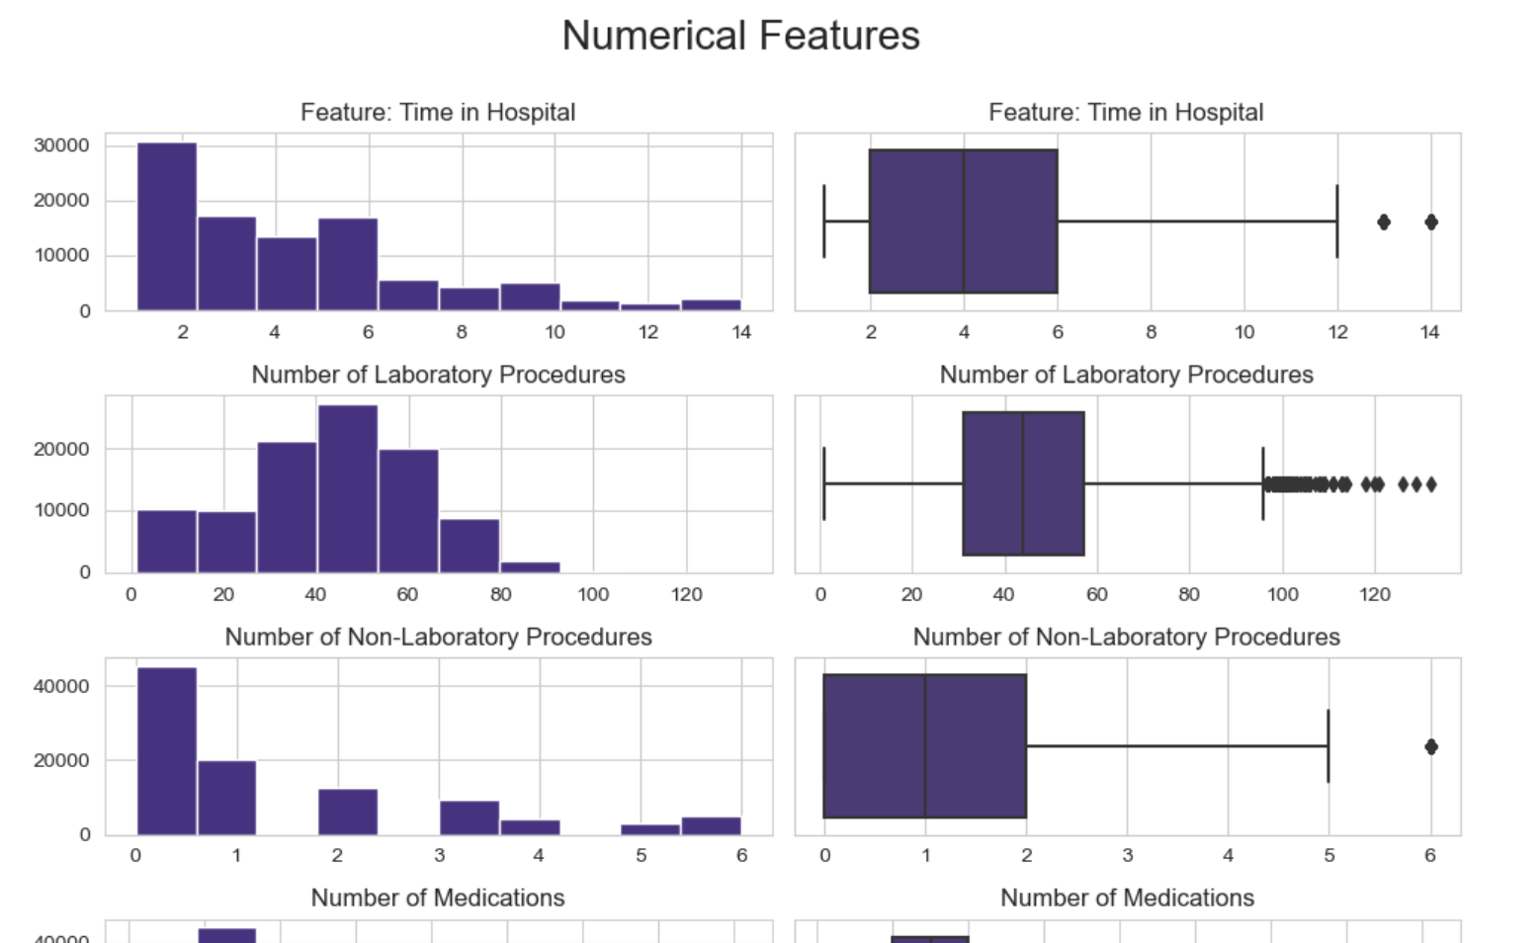
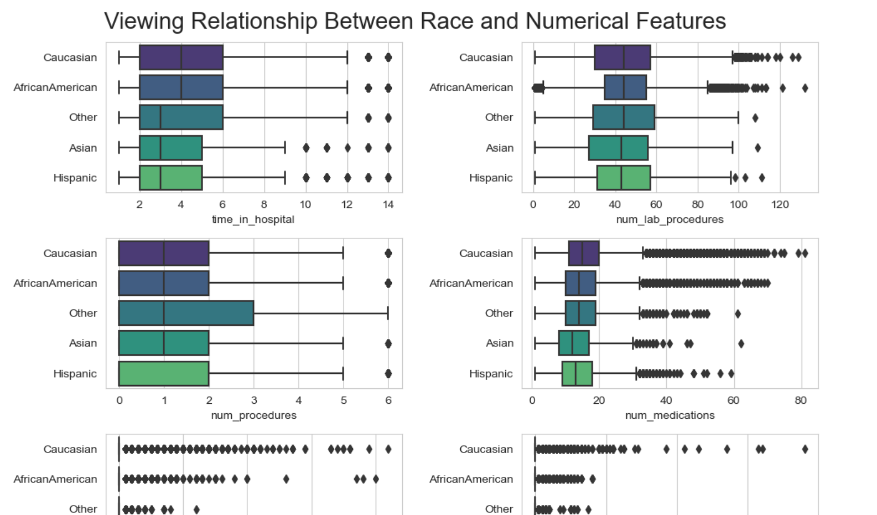
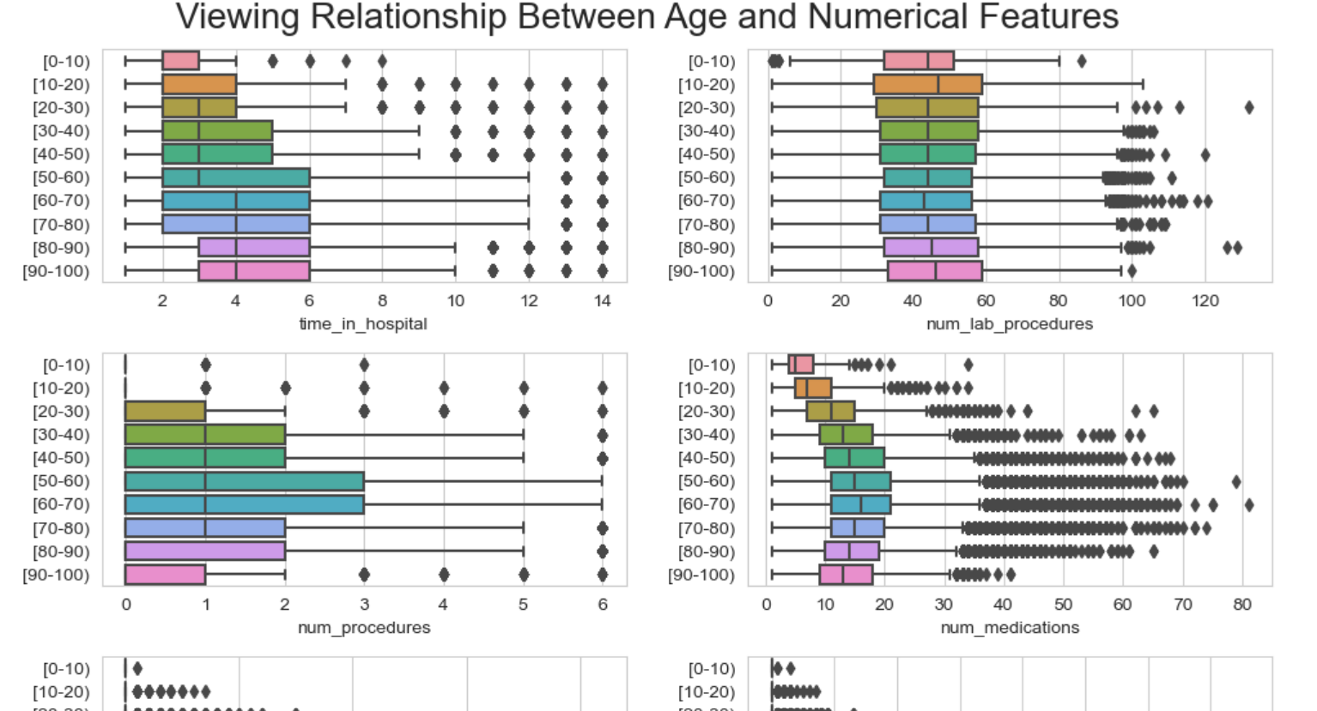
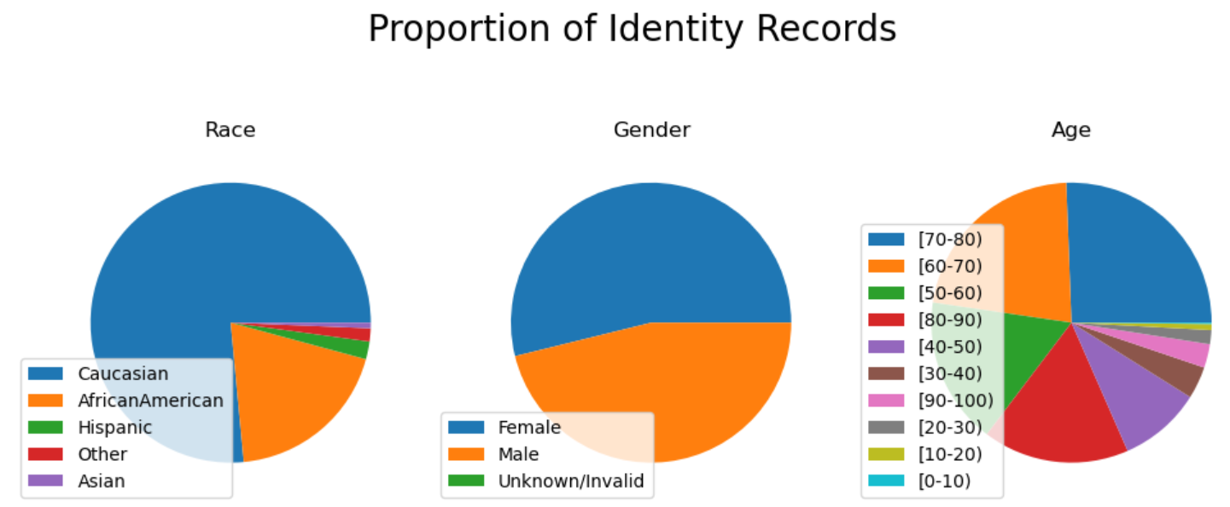
Results – Exploratory Data analysis
Univariate and multivariate analysis didn’t identify anything very surprising.
Through this process it was decided that outliers may be an important part of the story and were included.
Notes:
You have provided a clear overview of your results. You have clearly explained the findings of your research as a logical outcome of your data analysis or other tasks. Results are placed in context and the significance of the results discussed. You have clearly presented and explained your key interpretations, solutions, and conclusions. The original research problem and question is clearly addressed, and any interpretations and conclusions are well-justified and appropriate for the conventions and standards of data science. Relevant examples, visuals, and supporting evidence are used as appropriate. Literature and prior work on the selected project has been returned to support interpretations and ground conclusions and recommendations, if relevant

Slide 15
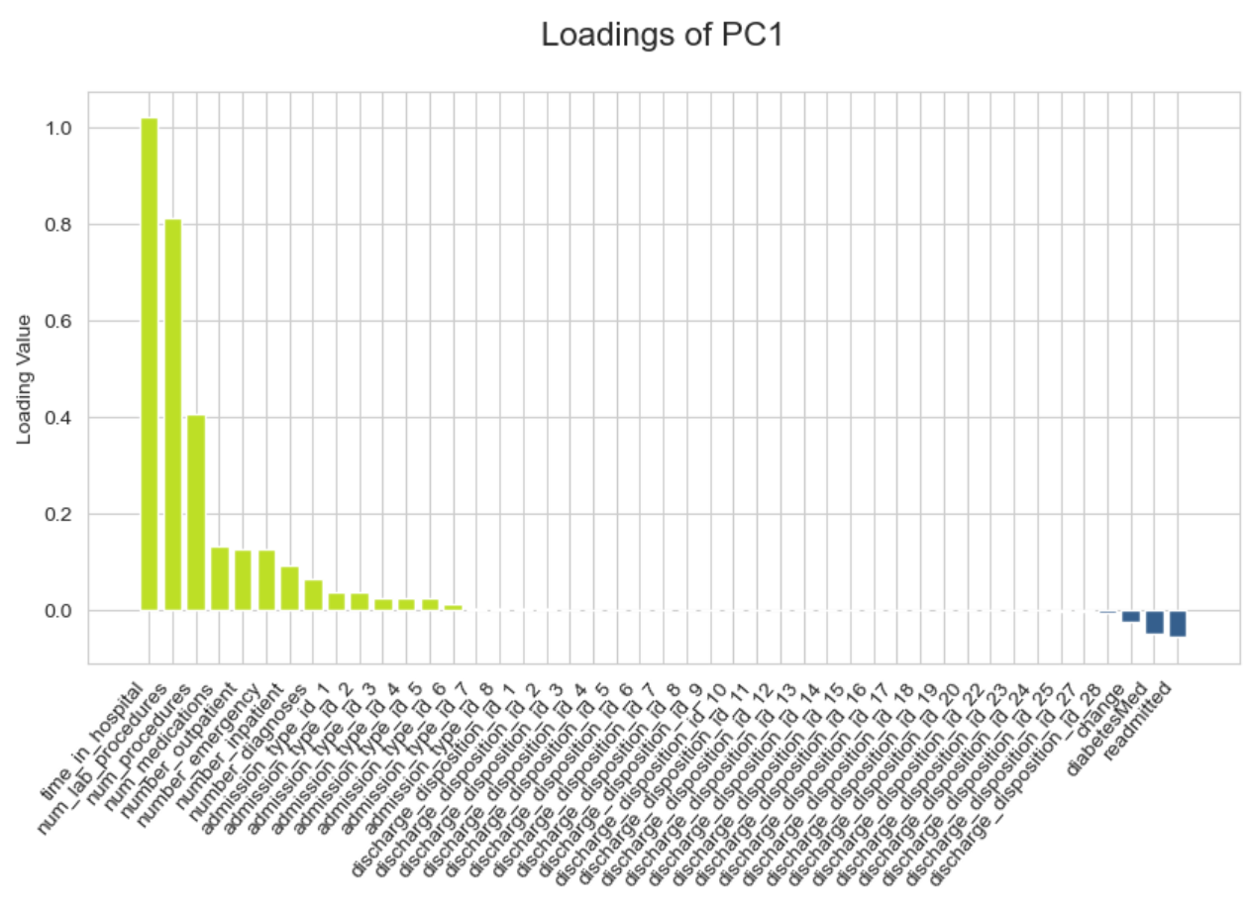
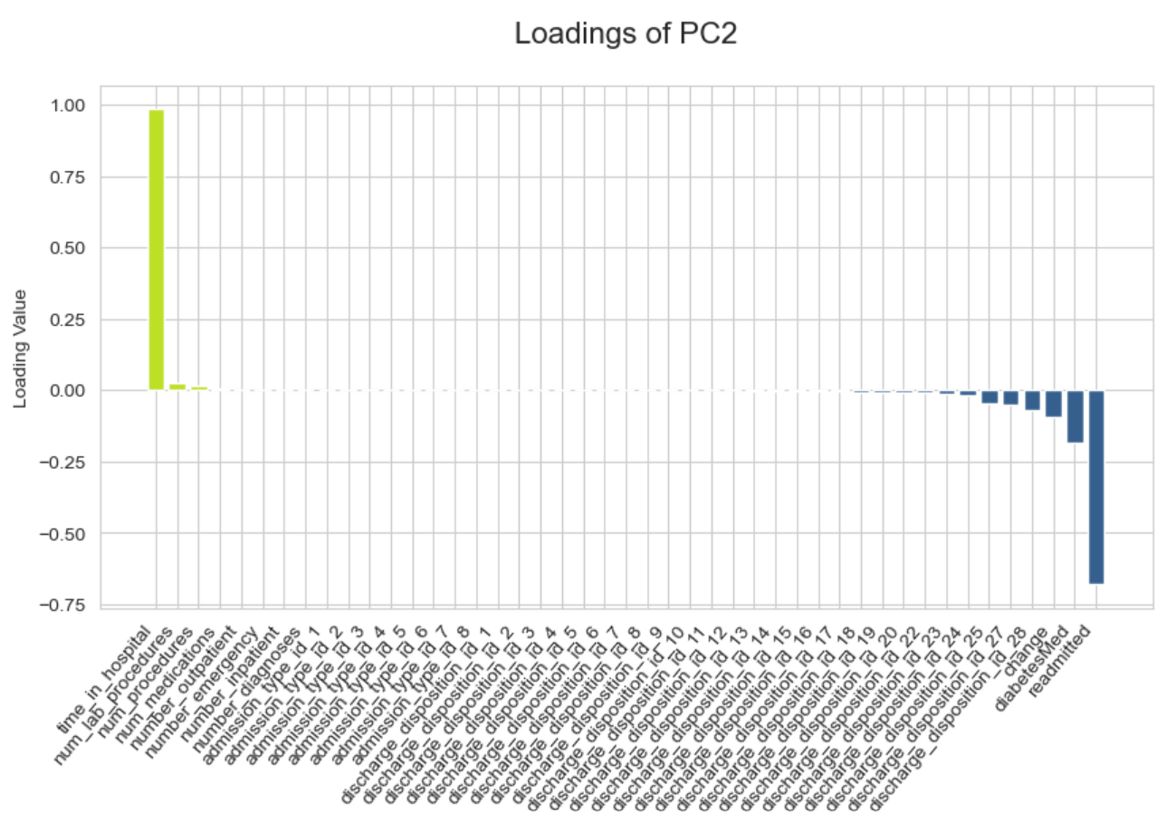
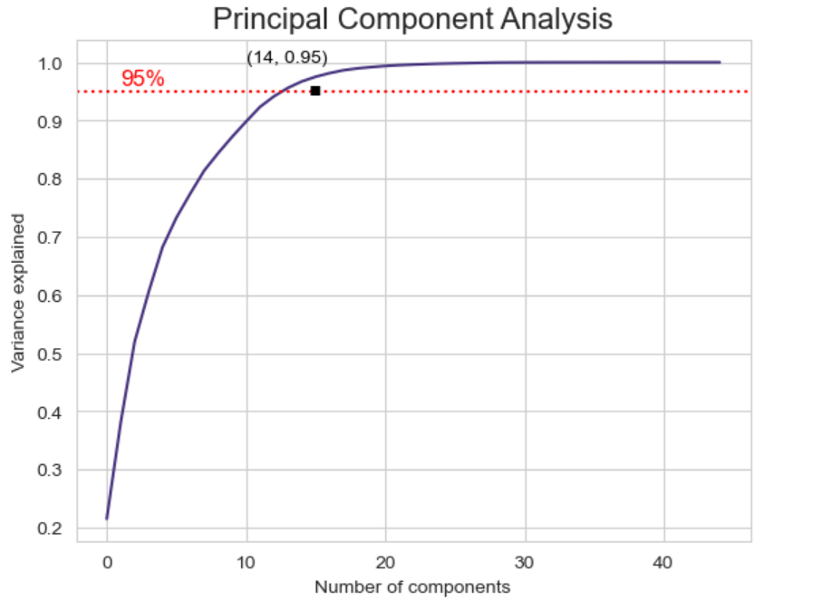
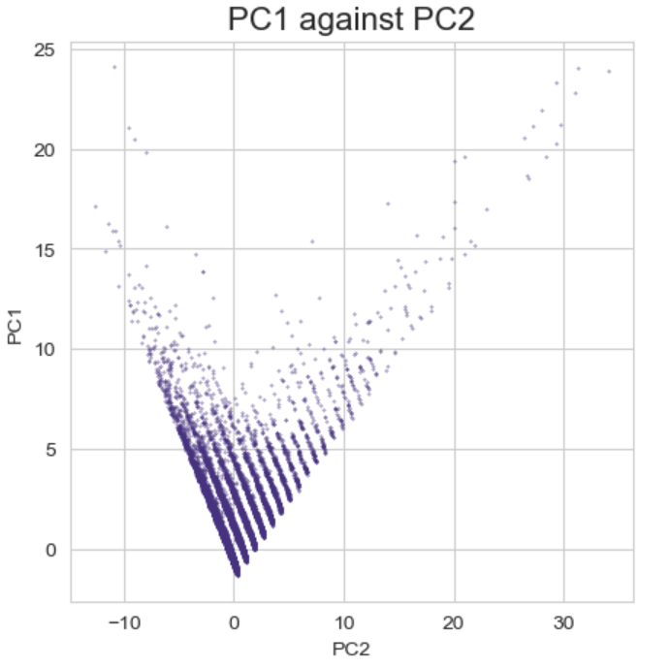
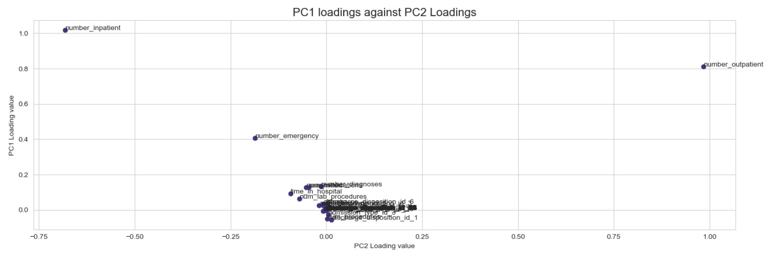
Results – Principal Component Analysis

Slide 16
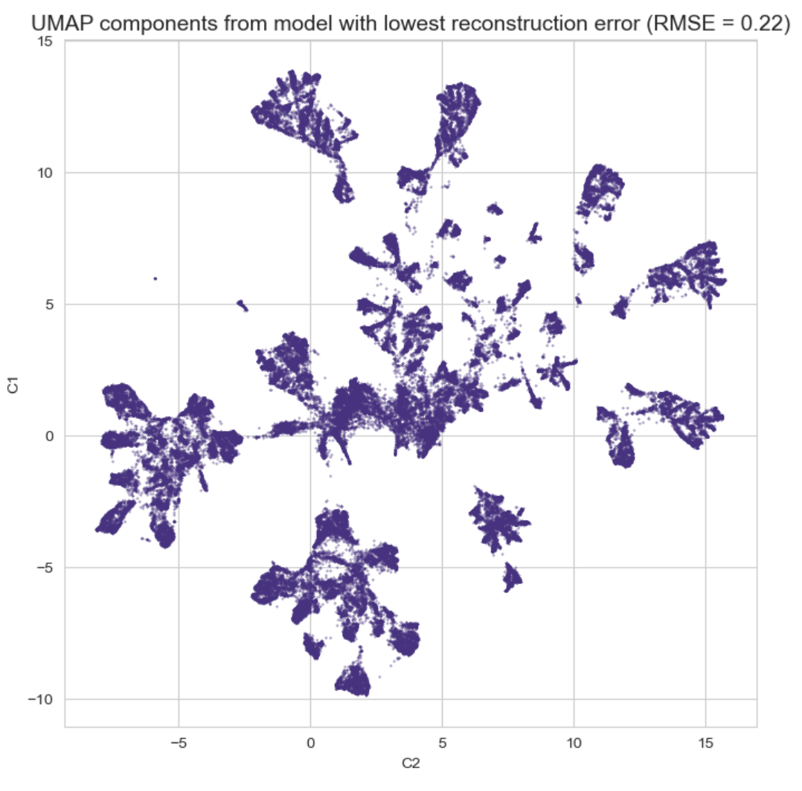
Results - UMAP

Slide 17
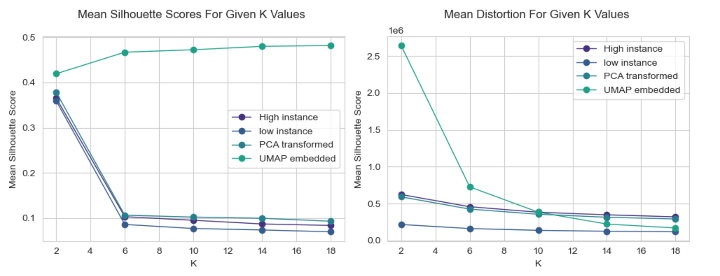
Results- Kmeans

Slide 18

Results - DBSCAN

Slide 19
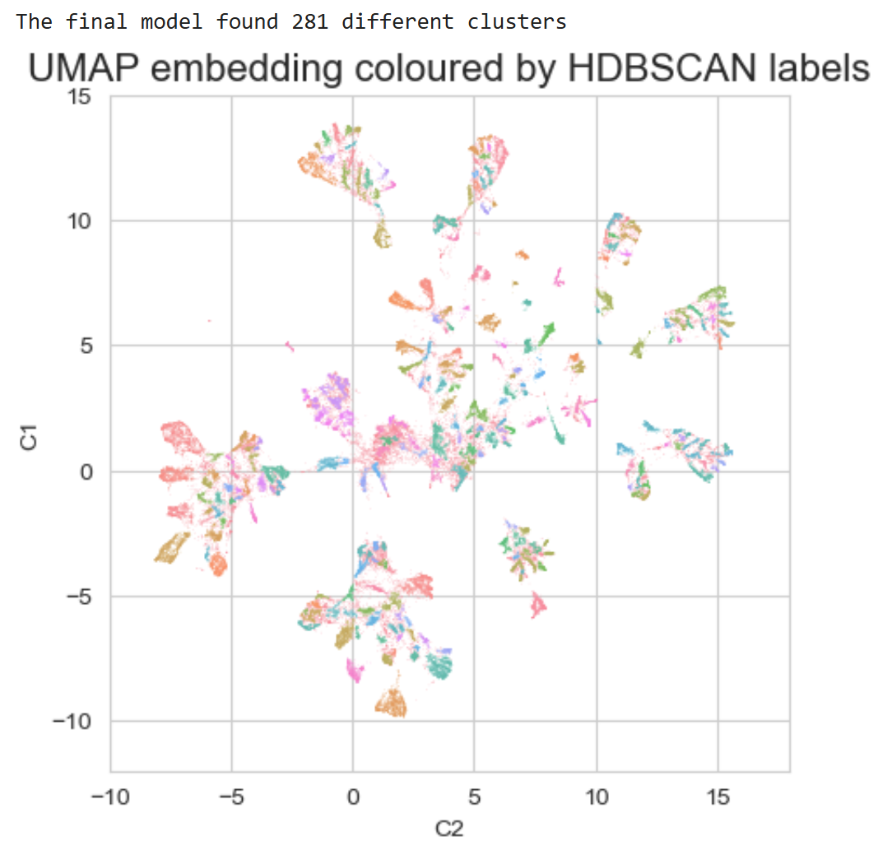
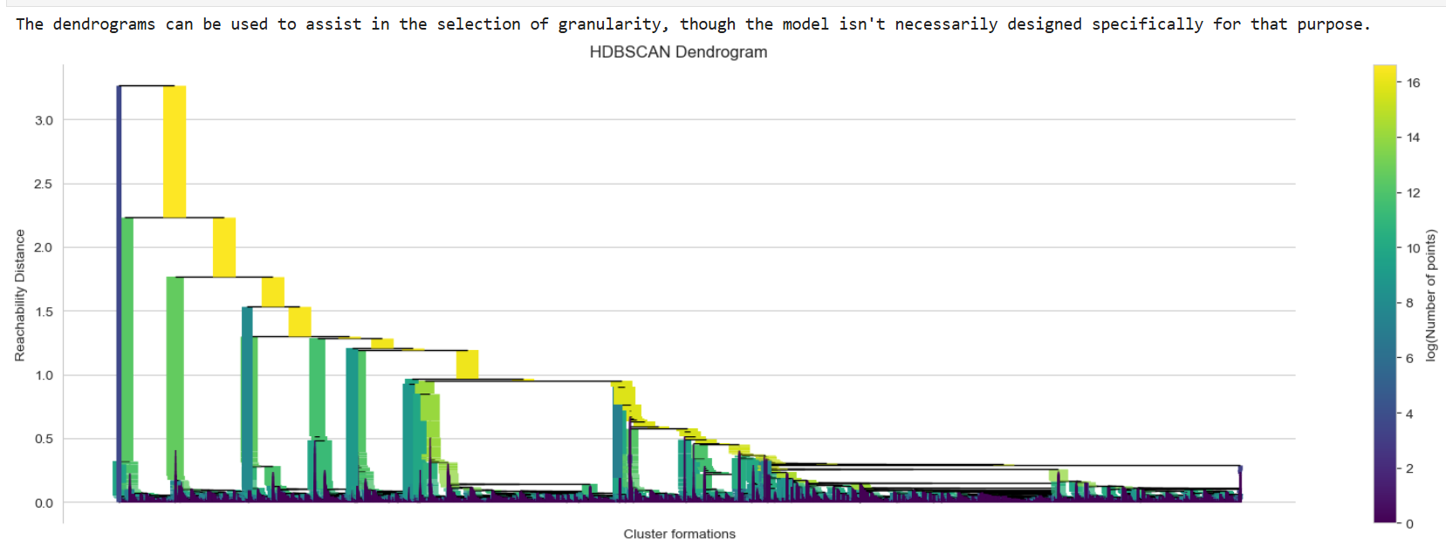
Results - HDBSCAN

Slide 20
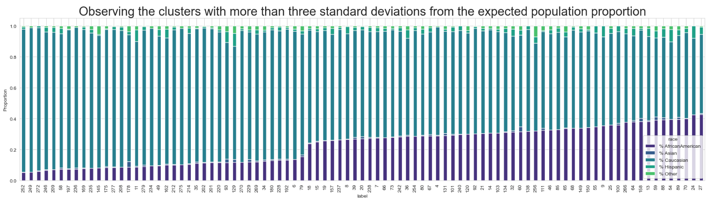
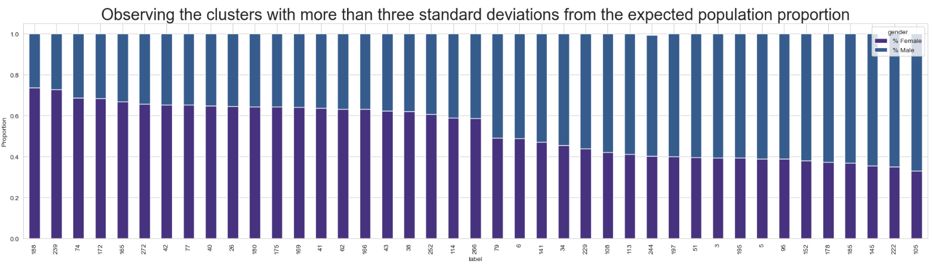
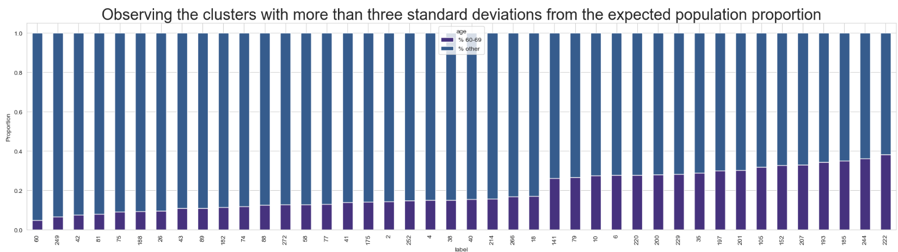
Results - Statistical Analysis

Slide 21
Conclusion
The project has demonstrated a methodology involving UMAP and HDBSCAN that:
Can locate potential patterns of bias
Has reasonable computational cost and low organizational cost
Encourages victim focussed dialogue, that isn’t reliant on self-reporting or survey responses,
Is conceptually simple.
Future research should seek to apply these tools on other datasets to confirm its utility. There is a growing need for real-time modelling to flag potential bias and provide decision makers an opportunity to reflect on their decision before serious harm occurs. Stronger validation methods for UMAP when used in an unsupervised manner would also be beneficial and provide added weight to any evidence found through the statistical analysis.

Slide 22
Demonstration
Notes:
You have provided a brief demo, included within your presentation, that effectively demonstrates and evidences your own coding work. The demo shows the code running (ideally block-by-block), describing each part of the code, explaining its purpose, and how it solves the problem. It is clear from your walkthrough that this is your own work, and that you understand the underlying code and data science techniques and skills involved.

Slide 23
References
Auerbach, AD, Kripalani, S, Vasilevskis, EE, Sehgal, N, Lindenauer, PK, Metlay, JP, Fletcher, G, Ruhnke, GW, Flanders, SA, Kim, C, Williams, MV, Thomas, L, Giang, V, Herzig, SJ, Patel, K, Boscardin, WJ, Robinson, EJ & Schnipper, JL 2016, 'Preventability and Causes of Readmissions in a National Cohort of General Medicine Patients', JAMA internal medicine, vol. 176, no. 4, pp. 484-493.
Aysolmaz, B, Iren, D & Dau, N 2020, 'Preventing algorithmic Bias in the development of algorithmic decision-making systems: A Delphi study'.
Bivens, R & Hoque, AS 2018, 'Programming sex, gender, and sexuality: Infrastructural failures in the “feminist” dating app Bumble', Canadian Journal of Communication, vol. 43, no. 3, pp. 441-459.
Bock, H-H 2007, 'Clustering Methods: A History of k-Means Algorithms', in Springer Berlin Heidelberg, pp. 161-172.
Caliskan, A, Ajay, PP, Charlesworth, T, Wolfe, R & Banaji, MR 2022, 'Gender Bias in Word Embeddings: A Comprehensive Analysis of Frequency, Syntax, and Semantics', paper presented at Proceedings of the 2022 AAAI/ACM Conference on AI, Ethics, and Society, Oxford, United Kingdom.
Citro, CF, Dabady, M & Blank, RM 2004, Measuring Racial Discrimination, National Academies Press, Washington, D.C., UNITED STATES.
Drobot, AT 2020, 'Industrial Transformation and the Digital Revolution: A Focus on Artificial Intelligence, Data Science and Data Engineering', in IEEE.
Ezugwu, AE, Shukla, AK, Agbaje, MB, Oyelade, ON, José-García, A & Agushaka, JO 2021, 'Automatic clustering algorithms: a systematic review and bibliometric analysis of relevant literature', Neural Computing and Applications, vol. 33, no. 11, 2021/06/01, pp. 6247-6306.
Fraser, L-A, Twombly, J, Zhu, M, Long, Q, Hanfelt, JJ, Narayan, KMV, Wilson, PWF & Phillips, LS 2010, 'Delay in Diagnosis of Diabetes Is Not the Patient's Fault', Diabetes Care, vol. 33, no. 1, pp. e10-e10.
Garcia, ACB, Garcia, MGP & Rigobon, R 2024, 'Algorithmic discrimination in the credit domain: what do we know about it?', AI &amp; SOCIETY, vol. 39, no. 4, pp. 2059-2098.
Greenwald, AG, Dasgupta, N, Dovidio, JF, Kang, J, Moss-Racusin, CA & Teachman, BA 2022, 'Implicit-Bias Remedies: Treating Discriminatory Bias as a Public-Health Problem', Psychological Science in the Public Interest, vol. 23, no. 1, pp. 7-40.
Jindal, M, Chaiyachati, KH, Fung, V, Manson, SM & Mortensen, K 2023, 'Eliminating health care inequities through strengthening access to care', Health Services Research, vol. 58, no. S3, pp. 300-310.
Kang, J & Lane, K 2010, 'Seeing through colorblindness: Implicit bias and the law', UCLa L. rev., vol. 58, p. 465.
Klein, TA 2016, 'Exploring the ethical and societal implications of market segmentation and targeting: Macromarketing and distributive justice perspectives', Social Business, vol. 6, no. 2, pp. 109-124.
Köchling, A & Wehner, MC 2020, 'Discriminated by an algorithm: a systematic review of discrimination and fairness by algorithmic decision-making in the context of HR recruitment and HR development', Business Research, vol. 13, no. 3, pp. 795-848.
Notes:
The video presentation (including slides and speech) is of high-quality and follows the specified formatting and other requirements as outlined in the assessment instructions (slides to address, appropriate length and file format, etc.). Effective professional communication and multimedia presentation skills are demonstrated. The presentation is logically structured and with an appropriate level of detail. The video invites feedback from your Supervisor

Slide 24
Lawrence, BJ, Kerr, D, Pollard, CM, Theophilus, M, Alexander, E, Haywood, D & O’Connor, M 2021, 'Weight bias among health care professionals: a systematic review and meta‐analysis', Obesity, vol. 29, no. 11, pp. 1802-1812.
Lim, TW 2019, Industrial revolution 4.0, tech giants, and digitized societies, Springer.
Louhichi, M, Nesmaoui, R, Mbarek, M & Lazaar, M 2023, 'Shapley values for explaining the black box nature of machine learning model clustering', Procedia Computer Science, vol. 220, pp. 806-811.
Lugon Arantes, PDT 2021, 'The Due Diligence Standard and the Prevention of Racism and Discrimination', Netherlands International Law Review, vol. 68, no. 3, pp. 407-431.
McDavid, J 2020, 'The social dilemma', Journal of Religion and Film, vol. 24, no. 1, pp. 0_1-3.
McInnes, L & Healy, J 2018, 'UMAP: Uniform Manifold Approximation and Projection for Dimension Reduction', 02/09.
McInnes, L, Healy, J & Astels, S 2017, 'hdbscan: Hierarchical density based clustering', The Journal of Open Source Software, vol. 2, no. 11, p. 205.
McInnes, LH, John; Melville, James 2018, 'UMAP: Uniform Manifold Approximation and Projection Documentation', viewed November 15, 2024, <https://umap-learn.readthedocs.io/en/latest/index.html>.
Moerschel, L 2021, 'The Intersectionality of Anti-fat Prejudice'.
Nader, K 2020, 'DATING THROUGH THE FILTERS', Social Philosophy and Policy, vol. 37, no. 2, pp. 237-248.
Nagpal, A, Jatain, A & Gaur, D 2013, 'Review based on data clustering algorithms', in 2013 IEEE Conference on Information & Communication Technologies, pp. 298-303.
Naik, H, Murray, TM, Khan, M, Daly-Grafstein, D, Liu, G, Kassen, BO, Onrot, J, Sutherland, JM & Staples, JA 2024, 'Population-Based Trends in Complexity of Hospital Inpatients', JAMA internal medicine, vol. 184, no. 2, pp. 183-192.
Nakip, M, Gökmen, A & Mohammed, SA 2017, 'Financial Market Segmentation: An Application on Islamic Financial Markets', Journal of Applied Economics & Business Research, vol. 7, no. 4.
Narr, G 2021, 'The Uncanny Swipe Drive: The Return of a Racist Mode of Algorithmic Thought on Dating Apps', Studies in Gender and Sexuality, vol. 22, no. 3, 2021/07/03, pp. 219-236.
Recchia, DR, Cramer, H, Wardle, J, Lee, DJ, Ostermann, T & Lauche, R 2022, 'Profiles and predictors of healthcare utilization: using a cluster-analytic approach to identify typical users across conventional, allied and complementary medicine, and self-care', BMC Health Services Research, vol. 22, no. 1.
Rudin, C 2019, 'Stop explaining black box machine learning models for high stakes decisions and use interpretable models instead', Nature Machine Intelligence, vol. 1, no. 5, 2019/05/01, pp. 206-215.
Schäfer, J & Wiese, L 2022, 'Clustering-Based Subgroup Detection for Automated Fairness Analysis', in Springer International Publishing, Cham, pp. 45-55.
Notes:
The video presentation (including slides and speech) is of high-quality and follows the specified formatting and other requirements as outlined in the assessment instructions (slides to address, appropriate length and file format, etc.). Effective professional communication and multimedia presentation skills are demonstrated. The presentation is logically structured and with an appropriate level of detail. The video invites feedback from your Supervisor

Slide 25
Smith, CT, Ratliff, KA, Ortner, T & Vijver, F 2015, 'Implicit measures of attitudes', Behavior based assessment in psychology: Going beyond self-report in the personality, affective, motivation, and social domains, pp. 113-132.
Strack, B, Deshazo, JP, Gennings, C, Olmo, JL, Ventura, S, Cios, KJ & Clore, JN 2014, 'Impact of HbA1c Measurement on Hospital Readmission Rates: Analysis of 70,000 Clinical Database Patient Records', BioMed Research International, vol. 2014, pp. 1-11.
van Giffen, B, Herhausen, D & Fahse, T 2022, 'Overcoming the pitfalls and perils of algorithms: A classification of machine learning biases and mitigation methods', Journal of Business Research, vol. 144, 2022/05/01/, pp. 93-106.
Vázquez, FI, Zseby, T & Zimek, A 2020, 'Interpretability and Refinement of Clustering', in 2020 IEEE 7th International Conference on Data Science and Advanced Analytics (DSAA), pp. 21-29.
Yang, H, Jiao, L & Pan, Q 'A Survey on Interpretable Clustering', in IEEE.
Notes:
The video presentation (including slides and speech) is of high-quality and follows the specified formatting and other requirements as outlined in the assessment instructions (slides to address, appropriate length and file format, etc.). Effective professional communication and multimedia presentation skills are demonstrated. The presentation is logically structured and with an appropriate level of detail. The video invites feedback from your Supervisor

